Slide 1
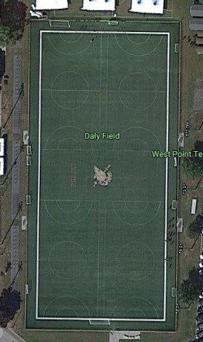
Vanessa Guillén Memorial Workout 18SEP2020
Workout
SPC vaNESSA GUILLÉN memorial workout : AMRAP 2x
400-meter Run
22 Burpees to Plate
9 Lunges (each leg)
30 Ground-to-Overheads with Plate 99 Air Squats
Rules
Don’t Quit.
Do your best to finish.
Help each other out
Mission:
B3 cadets conducts as many reps as they can of the workout in memory of the US Army Soldier Vanessa Guillén
Purpose: Dedicated to the US Army Soldier Vanessa Guillén
Key Tasks:
Ensure cadets are performing the exercise efficiently and safety (maintaining social distance)
Ensure cadets understand the purpose of this workout
Warm up before starting (stretches, etc.)
Ensure every cadet finishes or attempts to finish the workout
Endstate: B3 Bandits are dedicating their time and energy to the memorial workout.
Group 1
Timeline:
1640: meet on the apron
1650: begin movement to Daly field, set up equipment as necessary
1700: explain workout and the purpose of the workout
1710: begin workout
1800: complete workout and begin movement back to barracks
Location: Daly Field
Uniform: Gym Alpha, water source
Group 2
POC: CDT Grace Ko, grace.ko@westpoint.edu
CDT Joseph Watts, joseph.watts@westpoint.edu
Risk Mitigation:
Everyone has water source before step-off to ensure no heat casualties
Social Distancing (6-feet), wearing masks during movement
Assumptions:
Utilize the space and maintain social distancing
No other company will be using the field during this time

